Slide 1



Mind Sculptor
An Obsessive-Compulsive Disorder(OCD) Exposure and Response Prevention(ERP) Therapy Tool
24-25J-046

Slide 2

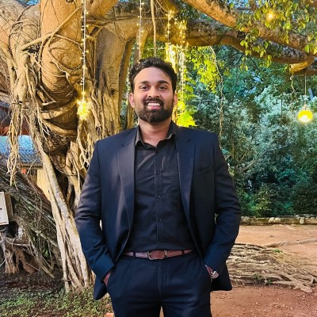
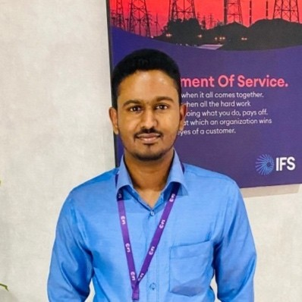

Our Team
Jayasighe P.T.
IT21234484
Mallawaarachchi D.E.H.
IT21209420
Illesinghe A.T.
IT21286278
Vithanage C.S.
IT21219498

Slide 3
INTRODUCTION
Obsessive-Compulsive Disorder(OCD) is a chronic psychiatric condition characterized by persistent intrusive thoughts (obsessions) and repetitive behaviors (compulsions).
It affects approximately 2-3% of the population and significantly impairs daily functioning and quality of life.
Traditional ERP therapy is effective but limited by accessibility and engagement challenges.
A comprehensive OCD ERP tool with advanced biometric monitoring and AI-driven therapeutic interventions has been identified as a valuable resource for enhancing the accessibility and effectiveness of obsessive-compulsive disorder treatment

Slide 4

Research Problem
How can AI and voice analysis improve the identification of OCD presence, subtypes and severity levels?
In what ways can biometric data and machine learning algorithms be used to create tailored ERP therapy plans for individual patients?
How can AI-supported Interactive Voice Assistant(IVA) increase patient engagement and accessibility to ERP therapy, particularly for those with logistical or psychological barriers?

Slide 5

Research Objectives
Main Objective
Sub Objectives
Develop an Exposure and Response Prevention(ERP) Therapy tool for patients suffering from OCD.
To enhance the diagnosis and understanding of OCD subtypes
To develop personalized and adaptive ERP therapy plans
To create AI-supported Interactive Voice Assistant(IVA)
To enable remote and real-time monitoring of therapy sessions

Slide 6
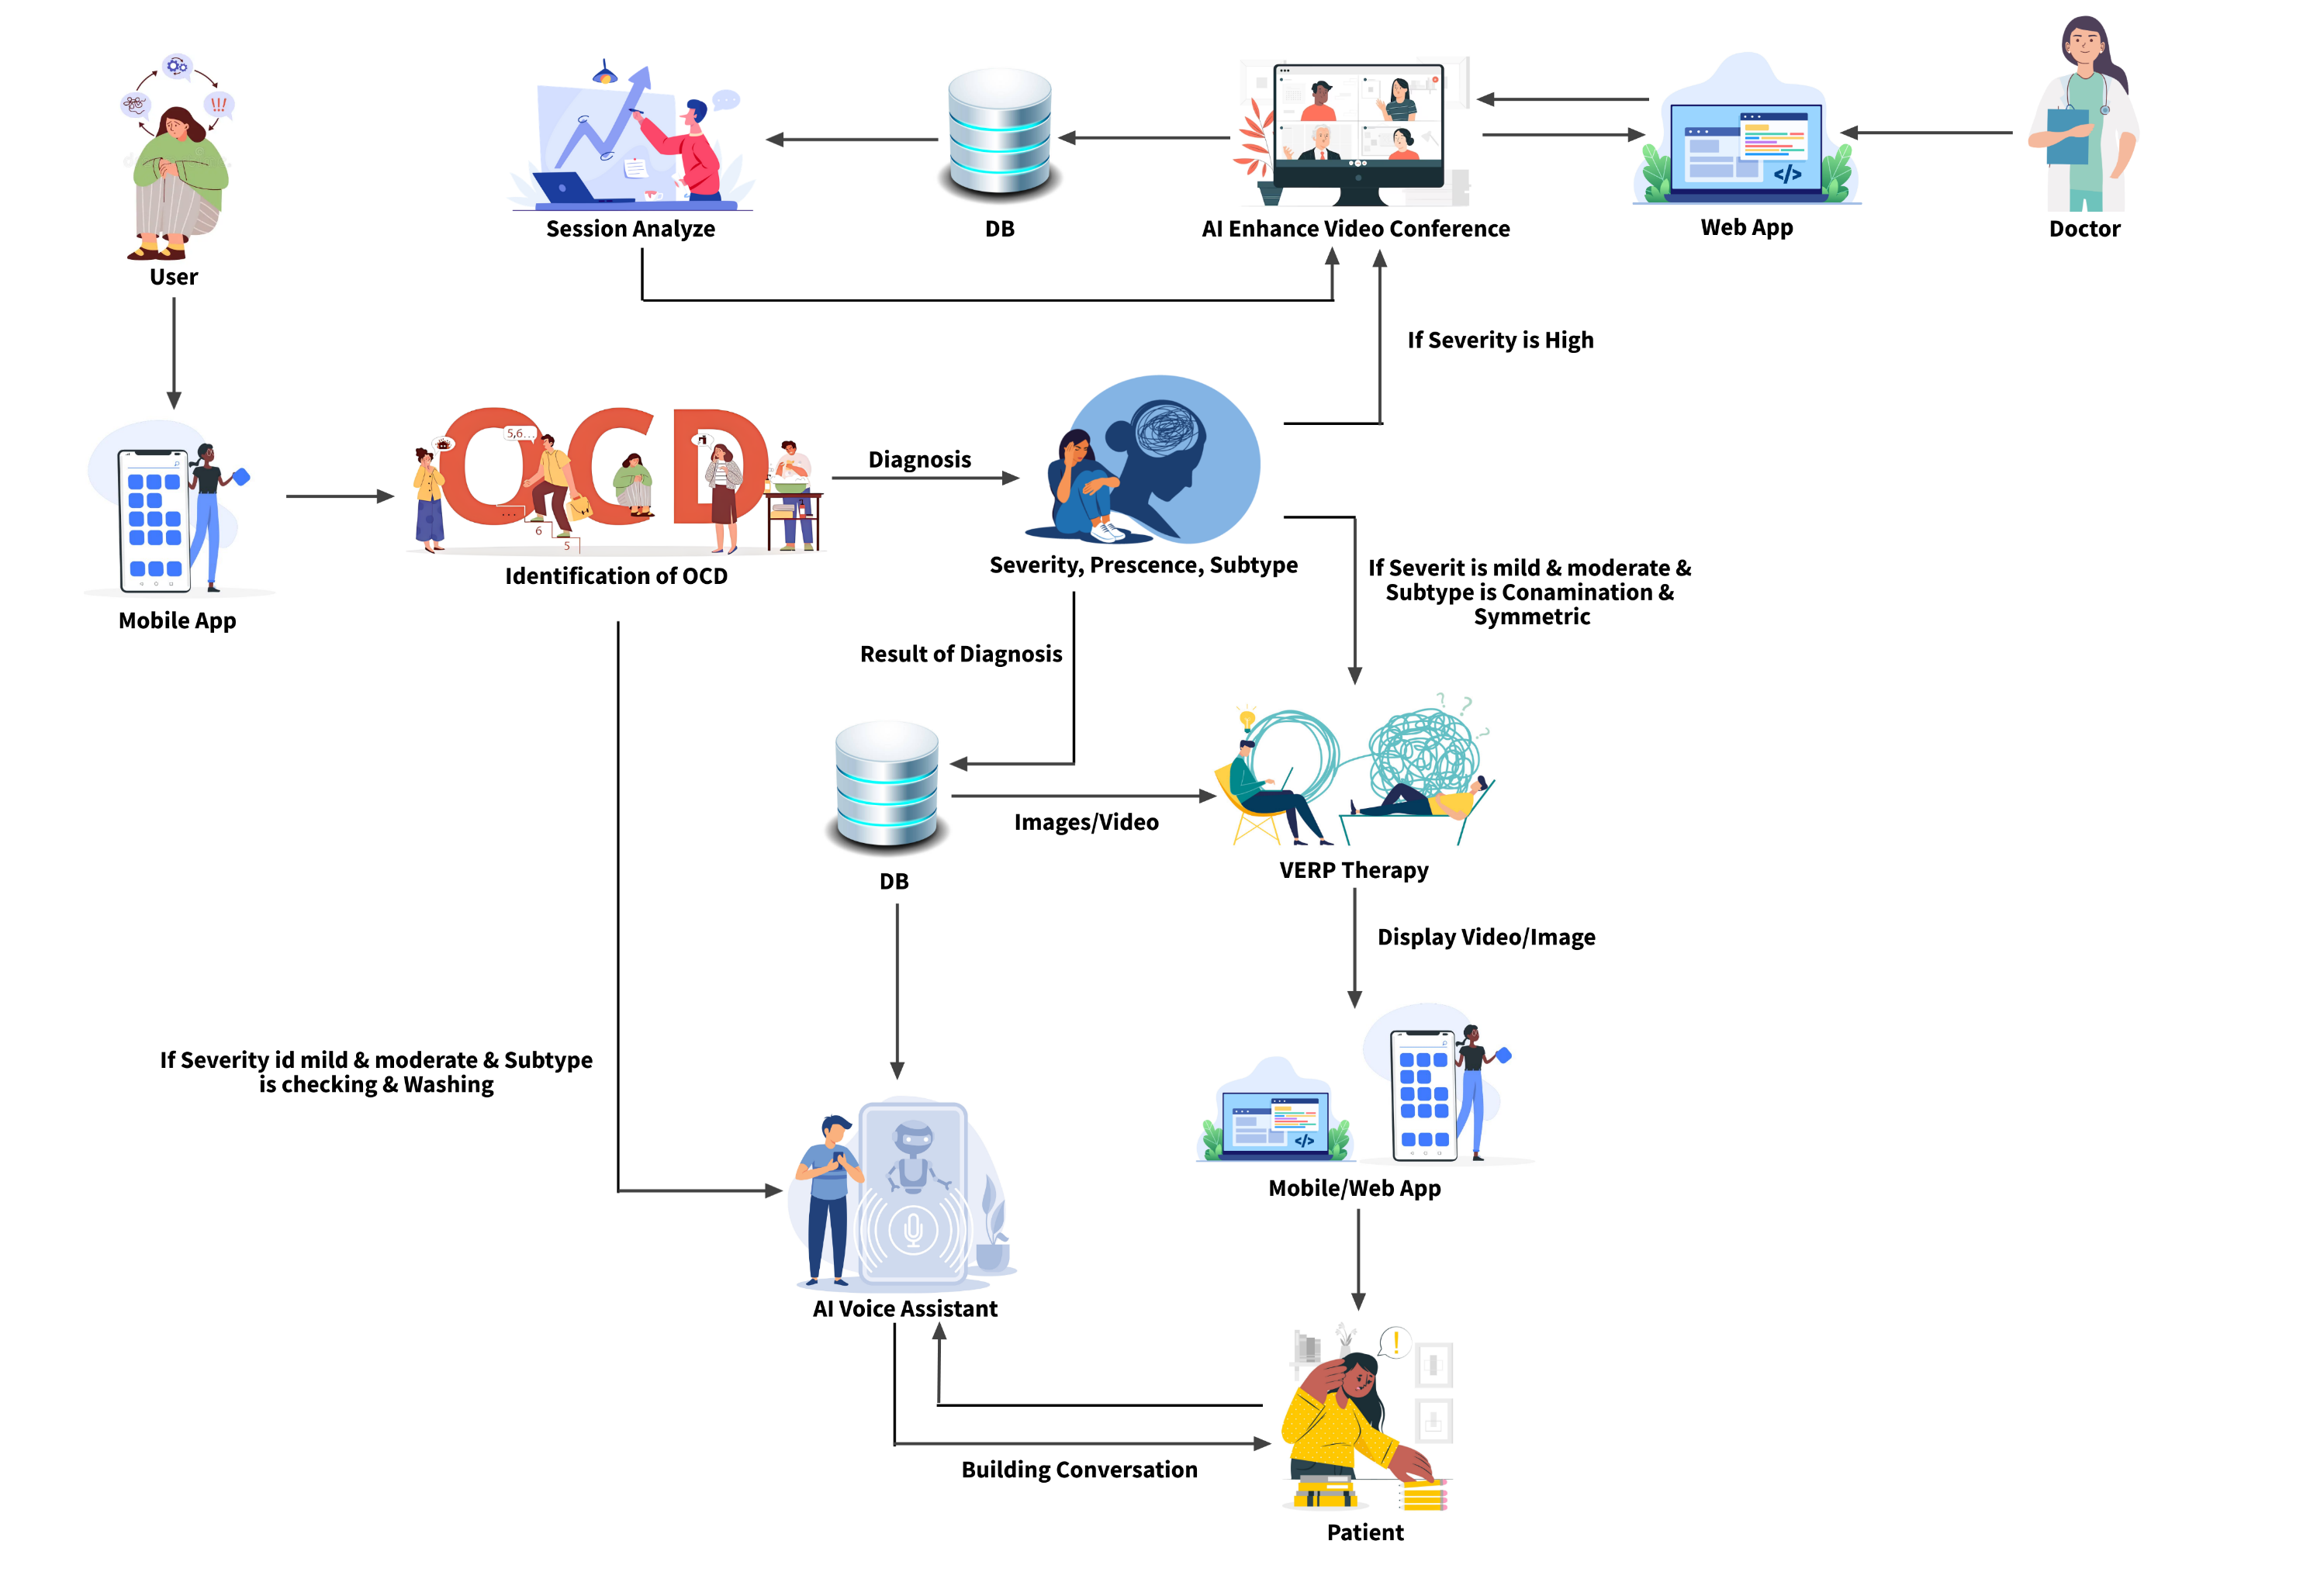
System Diagram

Slide 7
Psychology Experts
Dr. Roshan Fernando:
Psychiatrist guiding the overall research project, providing insights into OCD diagnosis and treatment
Ms. Sandaru Fernando:
Psychologist assisting in the development of the dataset and providing expertise in psychological assessment.

Slide 8

Data Collection

Slide 9
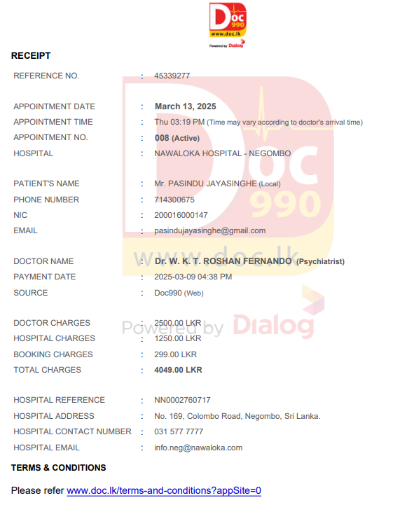
Feedback for PP1 comments from supervisors
Identification of presence, severity and subtype of OCD:
Refined the dynamic questionnaire to enhance accuracy by incorporating feedback. Validated that the questions align with established standards for OCD assessment.
Video Conferencing ERP Therapy Tool:
To ensure real-world applicability, anonymized anxiety related data from patients were analyzed to validate the system’s predictive accuracy.

Slide 10
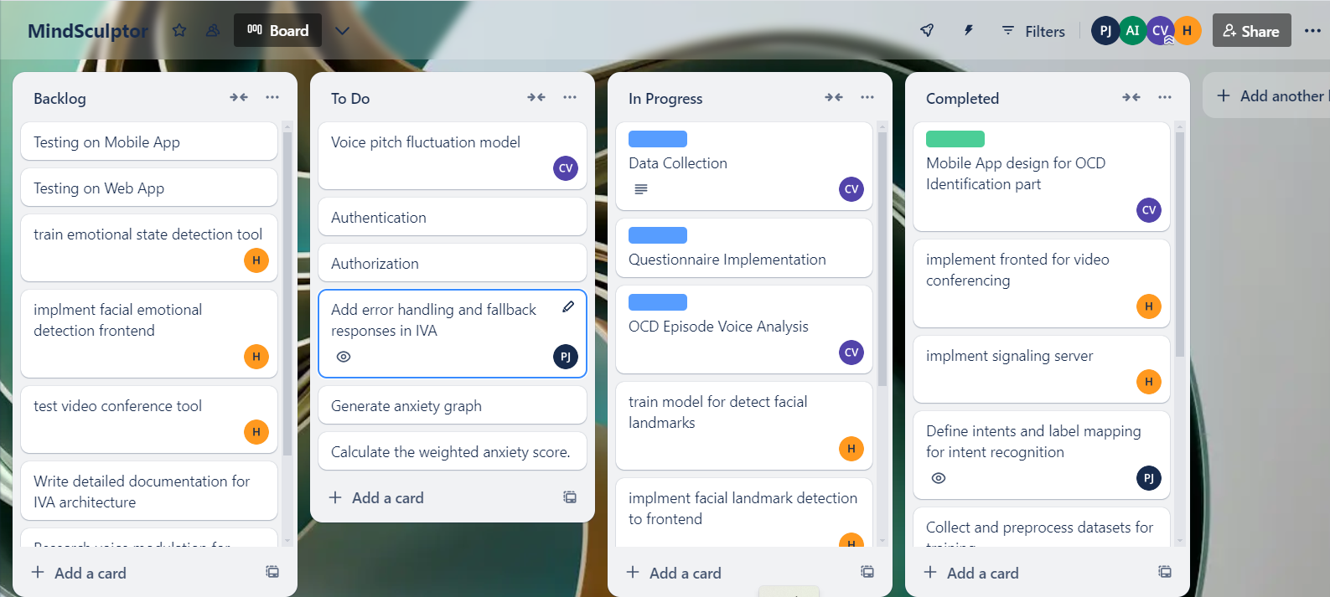
Best Practices Followed
Proper usage of Comments.
Project Management performed using Trello.

Slide 11
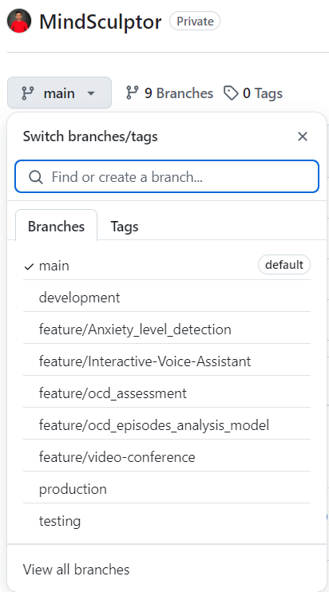
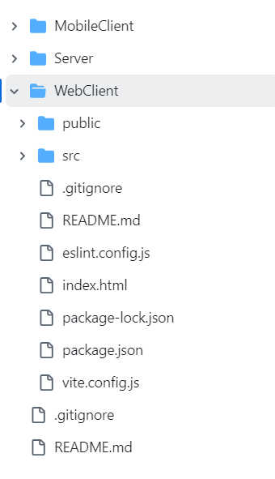
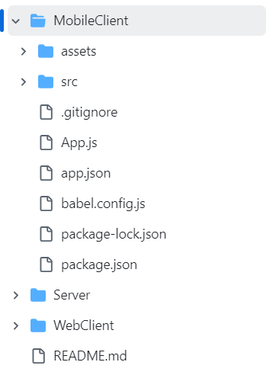
Best Practices Followed
Optimized Feature-vise and Environment-vise branching

Slide 12
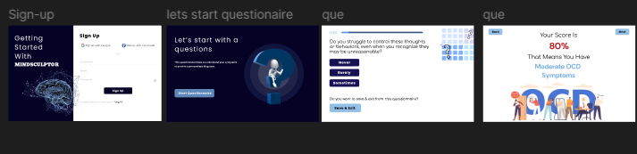
UI Design

Slide 13
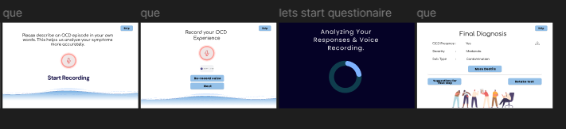
UI Design

Slide 14
Identify the presence, severity, and sub types of OCD in patients
IT21219498 | Vithanage C.S.
Specialization: Software Engineering
IT21219498 | Vithanage C.S | 24 – 25J – 046

Slide 15

Introduction
Background on OCD
Obsessive-Compulsive Disorder (OCD) is a mental health condition characterized by unwanted and intrusive thoughts (obsessions) and repetitive behaviors (compulsions).
It affects individuals' daily functioning and quality of life.
Importance of the Study
Identifying the presence, severity, and sub-types of OCD can lead to better diagnosis, treatment, and understanding of the disorder.
Accurate assessment helps in providing tailored interventions and improving patient outcomes.
IT21219498 | Vithanage C.S | 24 – 25J – 046

Slide 16

Research Questions
Primary Questions
How can the presence of OCD be accurately identified in patients using modern technological methods?
What are the most effective techniques to determine the severity of OCD symptoms?
How can different sub-types of OCD be classified and differentiated in patients?
Secondary Questions
Can voice recordings and speech analysis provide additional insights into OCD symptoms?
What algorithms and techniques are most suitable for these assessments?
IT21219498 | Vithanage C.S | 24 – 25J – 046

Slide 17

Objectives
Main Objective
Sub Objectives
Develop a comprehensive assessment method for identifying the presence, severity, and sub-types of OCD in patients.
Questionnaire-Based Assessment:
Implement a dynamic questionnaire to provide a preliminary diagnosis based on user responses.
OCD Episodes Analysis:
Leverages BERT for fine-tuned multi-class classification to identify OCD subtypes and severity levels from episode descriptions
Final Diagnosis:
Combine results from all sub-components to produce a comprehensive OCD diagnosis.

Slide 18
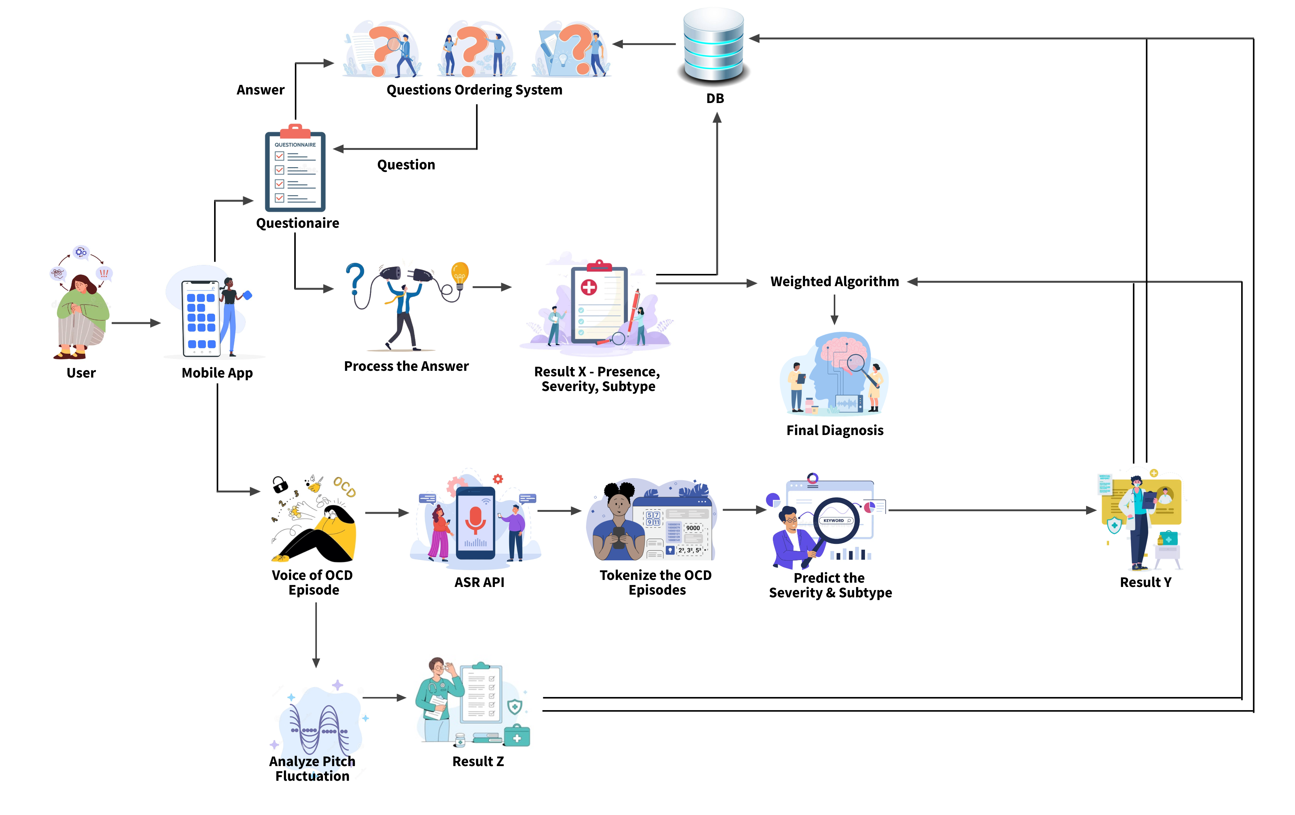
Methodology – System Diagram
IT21219498 | Vithanage C.S | 24 – 25J – 046

Slide 19
Methodology – Technologies, Techniques, Algorithms
Techniques
Technologies
Algorithms
React
Python
Flask
MongoDb
Matplotlib & Seaborn
Jupyter
Librosa
NLTK
Scikit-learn
Hugging Face Transformers
WordCloud
Speech recognition
Fine-Tuning BERT
Text Preprocessing
BERT
Weighted scoring algorithm
IT21219498 | Vithanage C.S | 24 – 25J – 046

Slide 20
Methodology – Completion and
Future Works
90% Completion of the component
Created a Comprehensive Dataset
Developed BERT-based models for predicting
Implemented dynamic questionnaire based on Y-BOCS and OCI-R standards.
Integrated Flask APIs for real-time predictions of subtype and severity.
Integrated the dynamic questionnaire with Web App.
Implement the Speech to Text Conversion of OCD episodes using ASR Api.
Combined the results of Questionnaire, OCD Episode analysis and Voice Pitch Analysis.
Implemented the UI Design and API Integrations.
Integrate the sub components
10% Future Enhancements
Test the application.
Enhance the UI Design.
Enhance the data privacy
IT21219498 | Vithanage C.S | 24 – 25J – 046

Slide 21
Enhanced Exposure and Response Prevention Therapy
IT21286278 | Illesinghe A.T.
Specialization: Software Engineering
IT21286278 | Illesinghe A. T. | 24 – 25J – 046

Slide 22
Introduction
Background
Exposure and Response Prevention(ERP) therapy is commonly used treatment by psychiatrists for patients diagnosed with Obsessive-Compulsive Disorder(OCD).
Exposure and Response Prevention(ERP) therapy, have proven effective in reducing symptoms and improving outcomes for OCD patients.
Enhanced Exposure and Response Prevention(VERP) is an innovative approach to treating OCD patients.
VERP uses advanced technology to simulate OCD-inducing scenarios and integrates biometric data to enhance the effectiveness of traditional exposure therapy.
VERP can be used to treat patients with symmetric OCD, contamination OCD.
IT21286278 | Illesinghe A. T. | 24 – 25J – 046

Slide 23

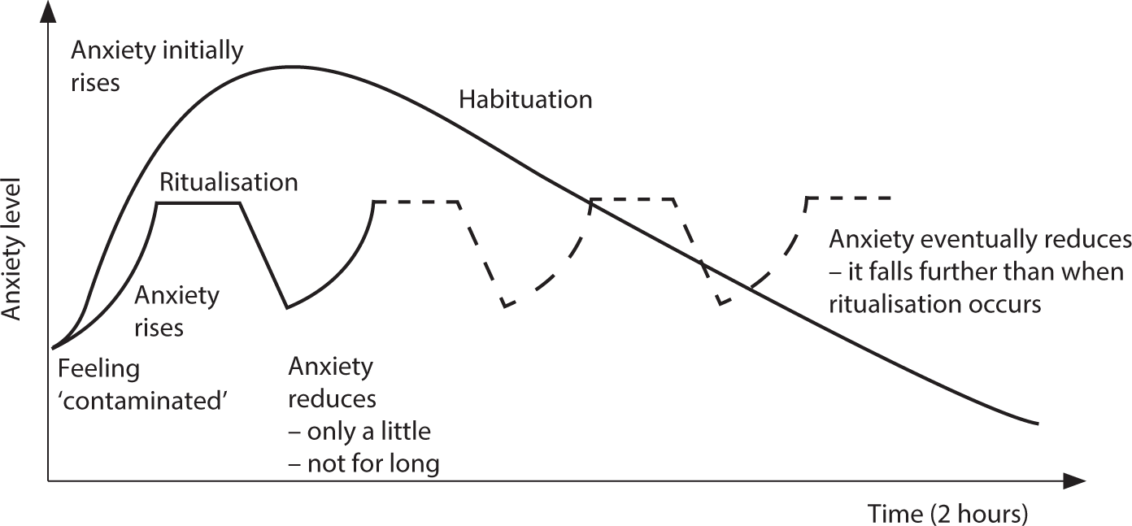
Introduction
Importance of the Study
First, the patient is exposed to an OCD-inducing scenario using images/videos.
Then the anxiety graph is generated using patient self-reported data and bio metric data.
Patients can seek the therapy on their own without consulting a doctor and reduce the symptoms of the OCD.
Patients can monitor the effectiveness of treatment by analyzing anxiety charts.
Contamination OCD
Anxiety graph
IT21286278 | Illesinghe A. T. | 24 – 25J – 046

Slide 24
Research Questions
How can we virtually expose patients to OCD inducing scenarios?
How can response prevention therapy be implemented using modern technology?
How can the accuracy of response prevention therapy be increased using modern technology?
IT21286278 | Illesinghe A. T. | 24 – 25J – 046

Slide 25
Objectives
Main Objective
Sub Objectives
Simulate real-life scenarios using tailored videos and images to expose the patient to OCD triggering scenario.
Capture biometric data and patient self-reported data during therapy session.
Generate the anxiety graph using captured biometric data and self-reported data.
Analyze anxiety graphs to predict the patient’s treatment efficacy.
To develop a therapy system that utilizes virtual simulations and biometric data to effectively treat Obsessive-Compulsive Disorder (OCD).
IT21286278 | Illesinghe A. T. | 24 – 25J – 046

Slide 26
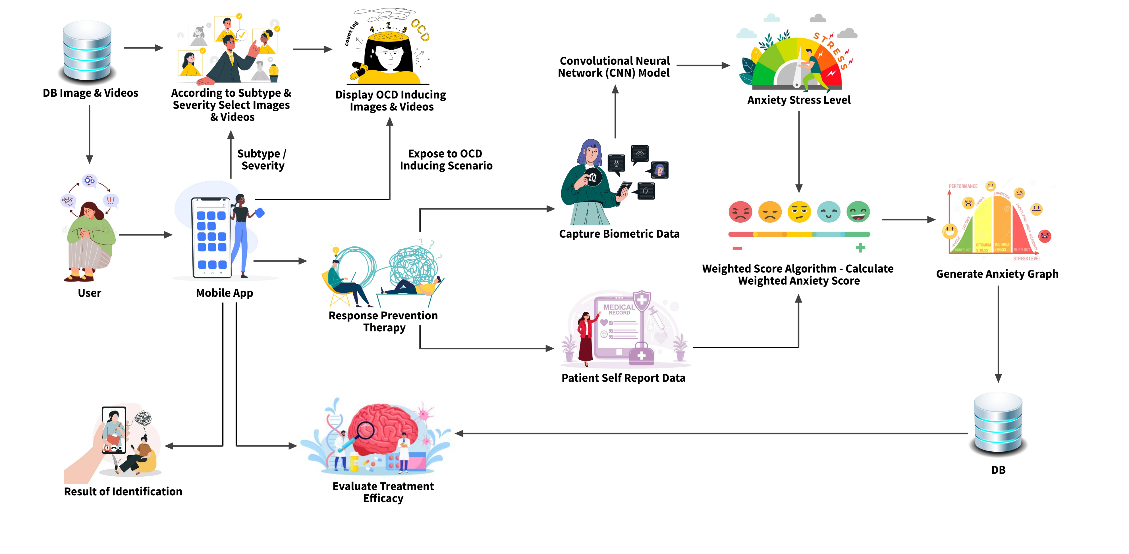
Methodology – System Diagram
IT21286278 | Illesinghe A. T. | 24 – 25J – 046

Slide 27
Methodology – Technologies, Techniques, Algorithms
Techniques
Technologies
Algorithms
Facial recognition
Emotion detection
Machine learning
Deep learning
Graph visualization.
React Native
TensorFlow
Python Flask
NodeJs
MongoDb/Mysql
Vscode
Google Colab
Keras
Convolutional Neural Network (CNN)
Decision Tree algorithm
Weighted scoring algorithm
CNN architectures
MobileNetV2
IT21286278 | Illesinghe A. T. | 24 – 25J – 046

Slide 28
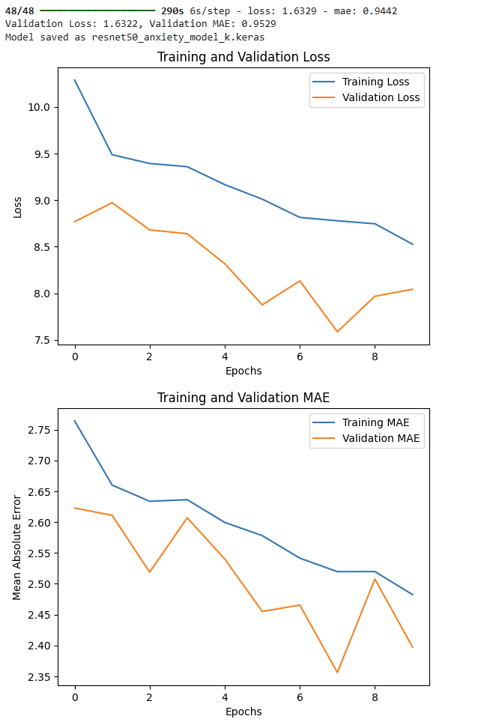
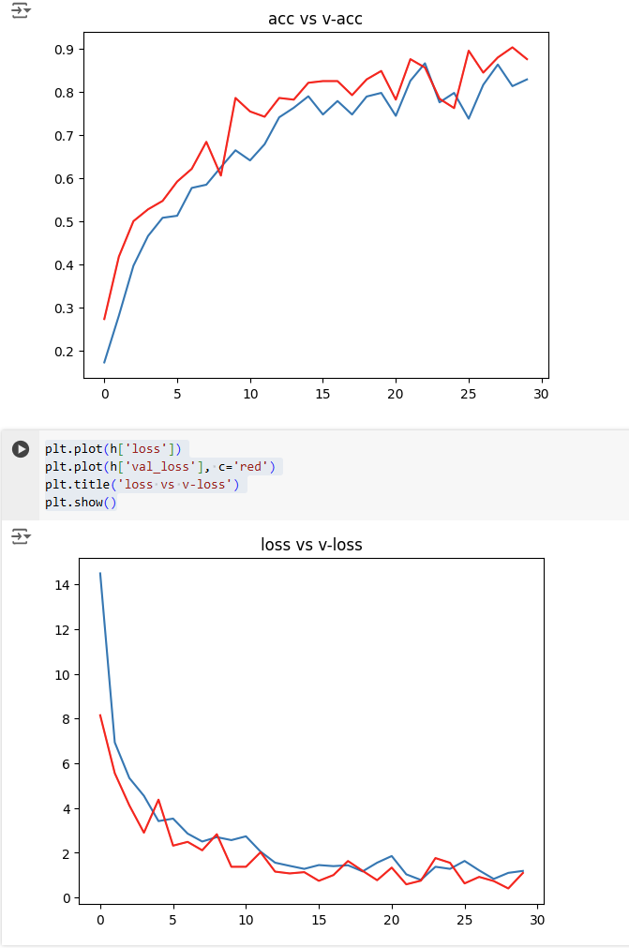
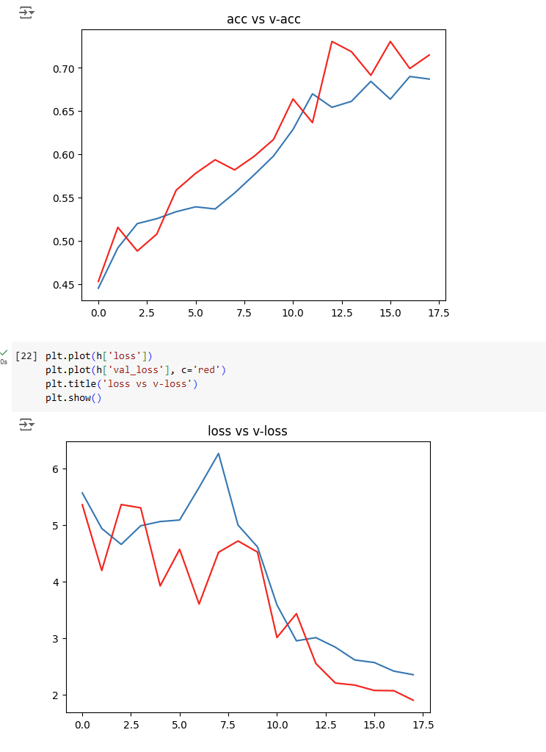
CNN Architectures
ResNet50
MobileNetV2
VGG16
Accuracy = 90.45
IT21286278 | Illesinghe A. T. | 24 – 25J – 046

Slide 29
Methodology – System, Personal, and Software Specification Requirement
Functional Requirements
Display appropriate image/video based on the OCD sub type and severity of the patient.
Capture accurate anxiety/stress level using emotion detection during the therapy.
Capture the patient self-reported data.
Calculate the weighted anxiety score accurately using facial expression data and user input data.
Generate the anxiety graph using the weighted anxiety score.
Analyze anxiety graphs of the patient.
Non-Functional Requirements
The application should be reliable and efficient.
Interfaces should be user-friendly.
The application should be compatible with different devices.
Patient data must be secure.
The results of VERP therapy must be accurate.
Software requirements
Python
Node
React
Vscode
MongoDB
Google Colab
Personal requirements
Guidance of external supervisors to acquire knowledge of healthcare domain.
Data set to train the CNN model.
IT21286278 | Illesinghe A. T. | 24 – 25J – 046

Slide 30
Completion and Future work
90% Completion of the component
Collect data and pre-process the data.
Train the CNN model to capture the anxiety level of the patient.
Train several models using different CNN architectures to identify the most suitable model.
Develop the functionality of display visual elements based on OCD subtype and severity.
Implement the functionality to capture anxiety levels by using the CNN model and by collecting self-reported values during the therapy session.
Calculate the weighted anxiety score.
Generate the anxiety graph at the end of the therapy session.
10% Future enhancements
Display the overview of all therapy session to see the progress.
Implement download option for the anxiety graph.
IT21286278 | Illesinghe A. T. | 24 – 25J – 046

Slide 31
AI Supported Interactive Voice Assistant
IT21234484 | Jayasinghe P.T.
Specialization: Software Engineering
IT21234484 | Jayasinghe P.T. | 24 – 25J – 046

Slide 32

Stigma in Society
Mental health disorders are often stigmatized, leading to fear of judgment or discrimination.
This stigma prevents many from openly discussing their struggles or seeking help, worsening their condition over time.
Reluctance to Seek Help
Concerns about being labeled or misunderstood result in a hesitation to pursue traditional therapy.
Cultural pressures and misconceptions around mental health reinforce the idea that seeking help is a sign of weakness.
Geographical Barriers
Access to mental health services is severely limited in rural and remote areas, where traveling to see a therapist can be impractical or impossible.
These geographical challenges create a significant gap in mental health care for those living in underserved regions.
Introduction
IT21234484 | Jayasinghe P.T. | 24 – 25J – 046

Slide 33
Research Questions
How can AI supported Interactive Voice Assistant enhance accessibility and personalization of ERP therapy for OCD patients?
IT21234484 | Jayasinghe P.T. | 24 – 25J – 046

Slide 34
Objectives
Main Objective
Sub Objectives
Conduct ERP Therapy Sessions for Contamination OCD Subtype.
Identification of Exposure Type and Severity Level of patients.
Generate Appropriate Therapeutic Responses
Utilize patient input to dynamically generate and provide personalized therapeutic responses during the therapy session.
Evaluate Patient Progress and Emotional Response
Implementation of an AI-Supported Interactive Voice Assistant for ERP Therapy in OCD
IT21234484 | Jayasinghe P.T. | 24 – 25J – 046

Slide 35
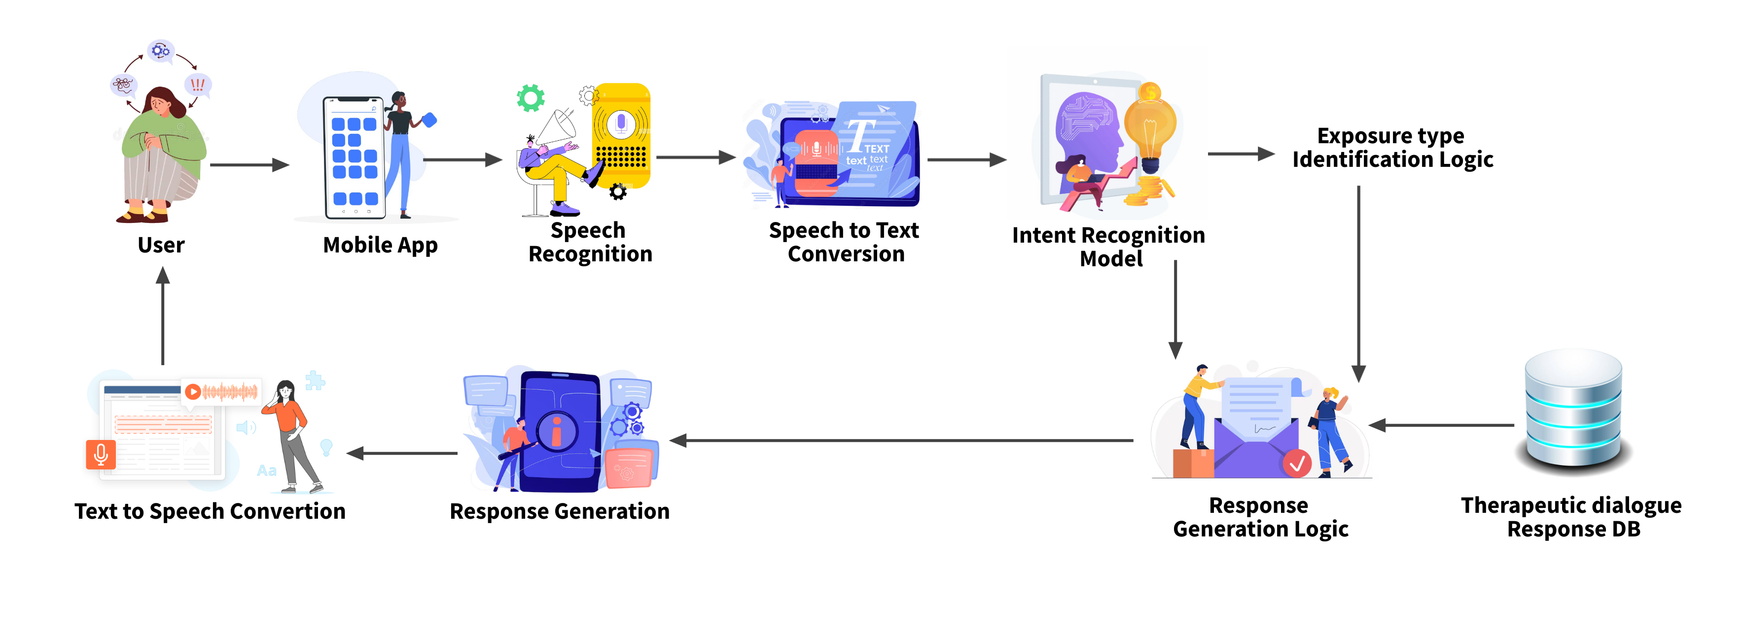
Methodology – System Diagram
IT21234484 | Jayasinghe P.T. | 24 – 25J – 046

Slide 36
Methodology – Technologies, Techniques, Algorithms
Techniques
Technologies
Algorithms
Expo
Flask
NodeJs
MongoDb
Python
Vscode
Google Colab
Transformers
TensorFlow
Matplotlib
Natural Language Processing
Speech recognition
Keyword detection
Machine learning
Rule-based Logic
Comparatuve Anxiety Graph Generation.
Matching Algorithm for Keyword-Based Exposure Type Detection.
State-Based Rule Logic for Conversational Flow
Metrics: Confusion Matrix, Classification Report.
Loss and Accuracy Tracking Across Epochs.
IT21234484 | Jayasinghe P.T. | 24 – 25J – 046

Slide 37
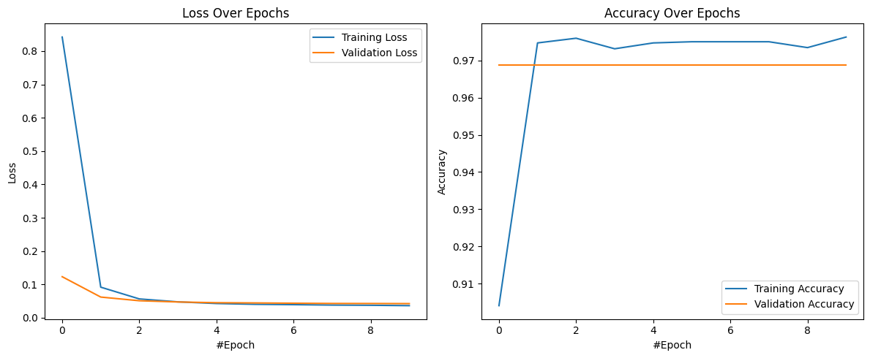
Intent Recognition DistilBERT Model
Loss – 0.0425
Accuracy – 0.9688
IT21234484 | Jayasinghe P.T. | 24 – 25J – 046

Slide 38
Completion and Future Works
90% Completion of the components
Fine-tuned a DistilBERT-based model for accurate intent classification.
Enhanced the keyword-based extraction system to accurately identify exposure types from user inputs.
Developed and tested a robust rule-based conversational flow tailored to OCD treatment.
for seamless voice-based interaction. Integrated Speech-To-Text and Text-To-Speech functionalities
Implemented anxiety graph generation to visualize anxiety fluctuations during therapy sessions.
10% Future Enhancements
Enable anxiety graph comparison across multiple sessions to track patient progress over time.
Optimize response generation.
IT21234484 | Jayasinghe P.T. | 24 – 25J – 046

Slide 39
AI-Enhanced Video Conferencing ERP Therapy
IT21209420 | Mallawaarachchi D.E.H.
Specialization: Software Engineering
IT21209420 Mallawaarachchi D.E.H | 24 – 25J – 046

Slide 40

Introduction
Background on OCD
Traditional ERP therapy for OCD needs a lot of time and specialized care, making it hard for many people to access.
Stigma around mental health makes people hesitant to seek help, which worsens their symptoms.
Importance of the Study
AI-enhanced video conferencing can make ERP therapy more accessible and offer personalized, real-time care.
Using biometric analysis, this method can better monitor anxiety and stress levels, improving treatment results.
IT21209420 Mallawaarachchi D.E.H | 24 – 25J – 046

Slide 41
Research Questions
Primary Questions
How does AI video therapy help OCD patients access treatment better than in-person therapy?
How effective is AI video therapy in reducing OCD symptoms?
How do patients feel about using AI video therapy? Is it easy and acceptable?
Secondary Questions
How does biometric analysis help track and improve outcomes in AI video therapy?
What are the cost differences between AI video therapy and traditional methods for patients and providers?
IT21209420 Mallawaarachchi D.E.H | 24 – 25J – 046

Slide 42

Objectives
Main Objective
Sub Objectives
Seamless Video Conferencing: Develop a platform for uninterrupted audio-video communication between patients and therapists.
Session Analytics: Provide detailed session metrics and predictive analytics to monitor patient progress.
Enhanced Feedback: Display critical facial expressions alongside live video for accurate therapist assessment.
Develop an AI-Enhanced Video Conferencing ERP Therapy tool to facilitate more accessible, personalized, and effective OCD treatment.
IT21209420 Mallawaarachchi D.E.H | 24 – 25J – 046

Slide 43
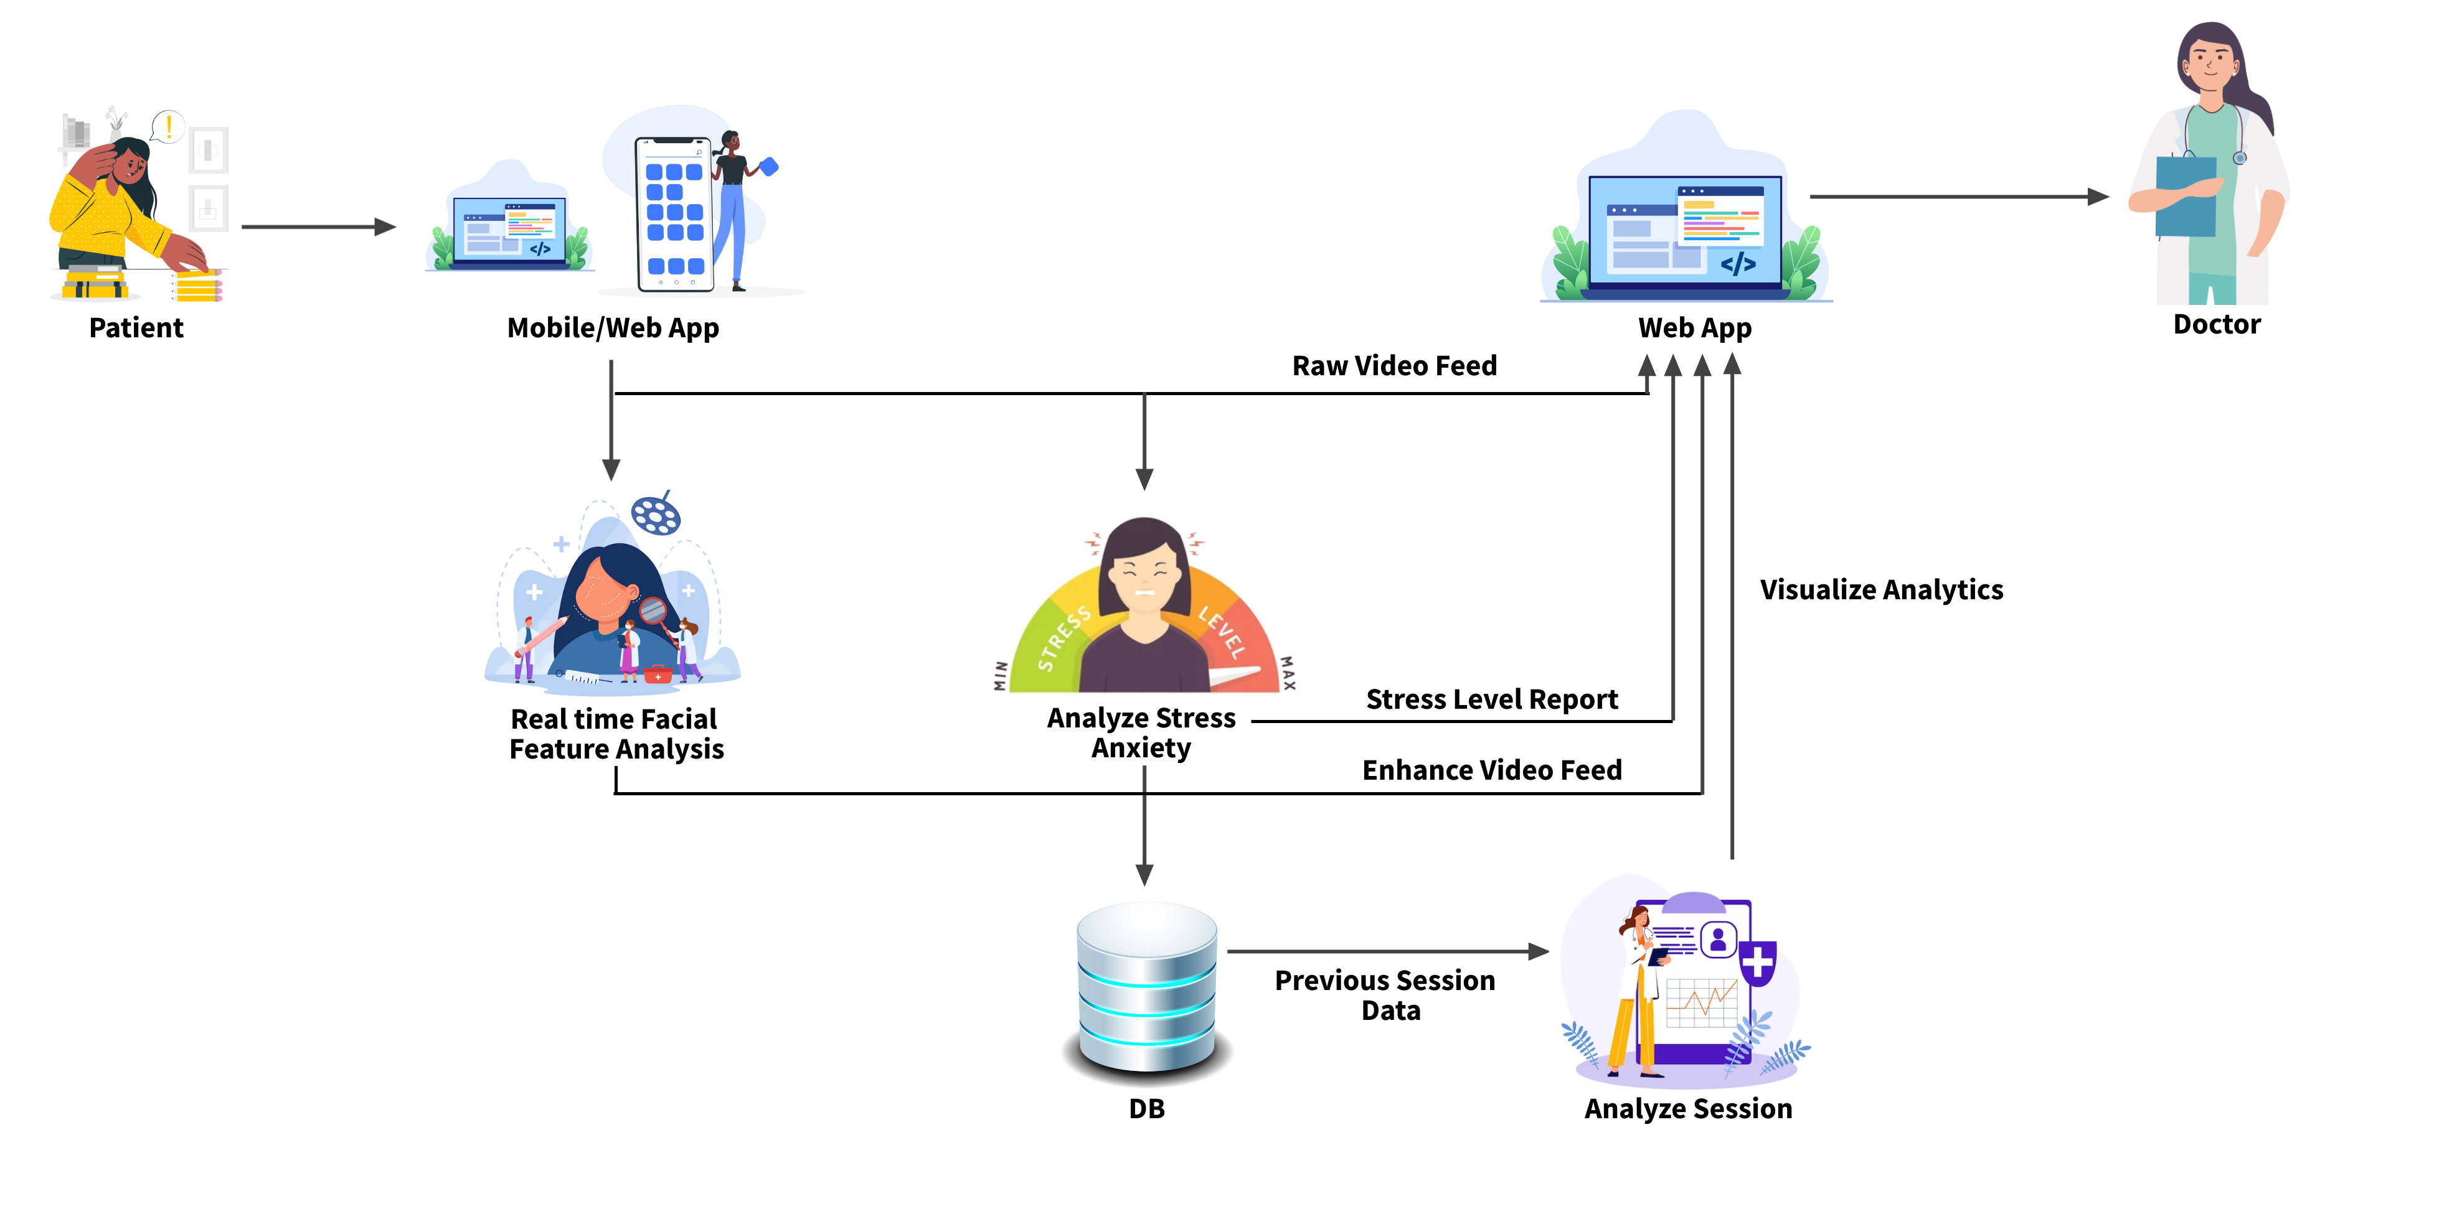
Methodology – System Diagram
IT21209420 Mallawaarachchi D.E.H | 24 – 25J – 046

Slide 44
Methodology – Technologies, Techniques, Algorithms
Techniques
Technologies
Algorithms
WebRTC
Node.js
Firebase
React
Python Flask
MongoDB
Google Colab
Facial Recognition
Emotion Detection
Real-time Facial Landmark Detection
Data Normalization
Feature Engineering
Data Validation
MediaPipe(CNN)
Gradient Boosting
Regression
IT21209420 Mallawaarachchi D.E.H | 24 – 25J – 046

Slide 45
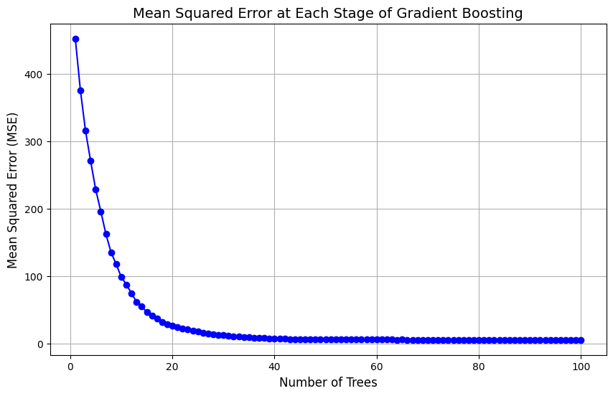
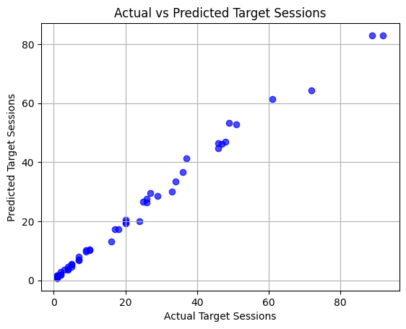
Data Visualization
IT21234484 | Jayasinghe P.T. | 24 – 25J – 046

Slide 46
Completion and Future Works
90% Completion of the components
Developed the frontend for the video conferencing tool, leveraging WebRTC for seamless real-time communication.
Implemented signaling server with firebase
Appointment management system.
Trained and deployed a predictive algorithm to estimate the required number of therapy sessions.
10% Future Enhancements
Implement doctor dashboard for more analytics
Implement payment portla
IT21234484 | Jayasinghe P.T. | 24 – 25J – 046

Slide 47
Thank You!

